Slide 1

Ergodicity of a System of Three Hard Spheres on a Ring
Matej Vedak
Notes:
Introduction
About the project
The title is a mouthfull but hopefully it becomes understandable by the end of the presentation

Slide 2
Ergodicity
- Wikipedia: point of a moving system will eventually visit all parts of the space that the system moves in, in a uniform and random sense
- Average behaviour of the system can be deduced from the trajectory of a „typical” point
- Ergodic systems capture the common-sense, every-day notions of randomness
- Pillar on top of which most statistical physics stands (in computational physics almost always assumed: average of a parameter over time is the same as the average over the statistical ensemble)
- Finance (Kelly Criterion for gambling and portfolio theory)
Notes:
Does anyone know what ergodicity is?
Property of a system
Eventually the system visits all of its phase space
Computational physics – metropolis algorithm for spin Glauber dynamics
Kelly criterion – formula that determines the optimal theoretical size for a bet, dependent on the probability of winning and the winning coefficient. Maximze the expected value of the logarithm of wealth

Slide 3
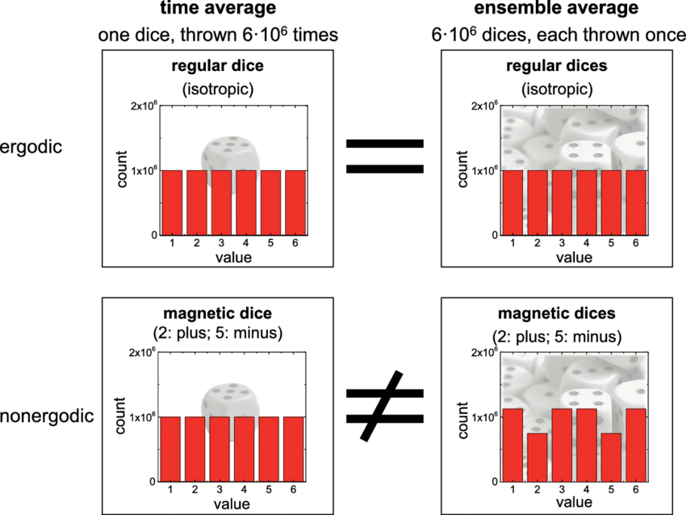

Slide 4
Hard Ball Systems and Ergodicity
- Far from clear that a deterministic system will visit all available microstates
- Hard ball systems are complex enough to exhibit non-trivial ergodicity but simple enough to observe its phase space
Notes:
„The fact that classical equilibrium statistical mechanics works is deeply puzzling” – Peter Vranas in Epsilon-Ergodicity and the Success of Equilibrium Statistical Mechanics
This is why simple colliding hard balls are most often studied
Nandor Simanyi. “Proof of the Ergodic Hypothesis for Typical Hard Ball Systems”.

Slide 5
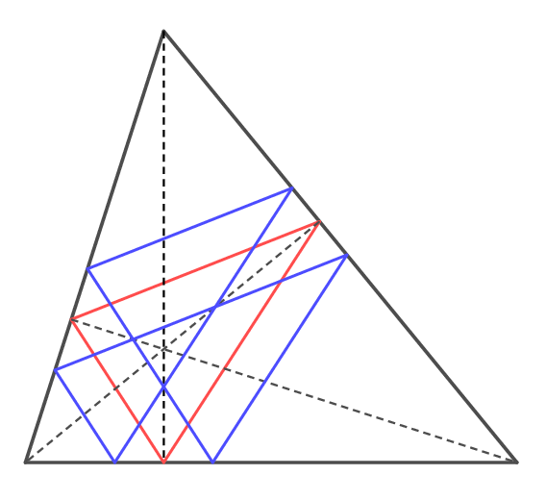
Notes:
Sheldon Lee Glashow and Laurence Mittag. “Three rods on a ring and the triangular billiard”.

Slide 6
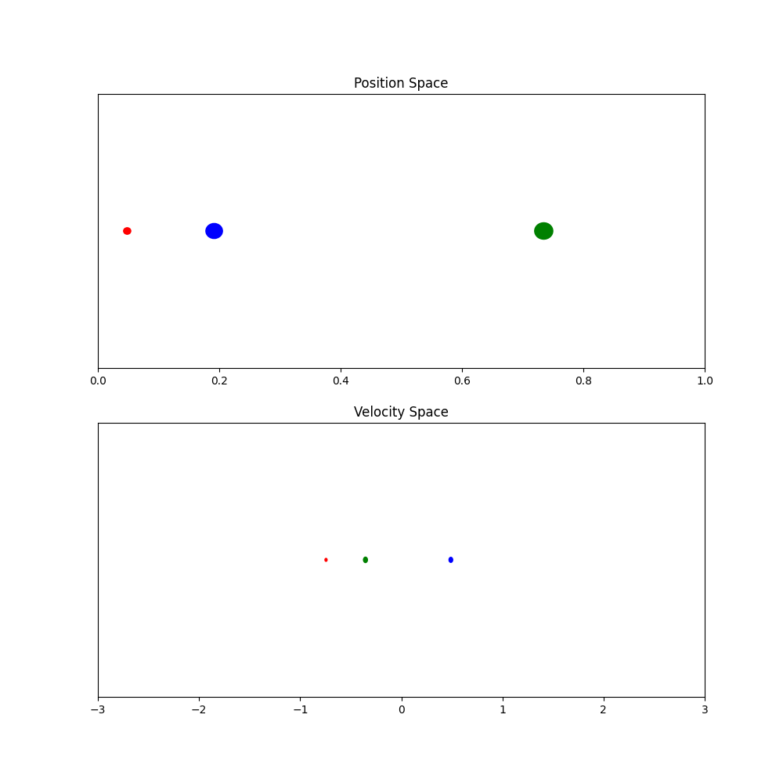

Slide 7
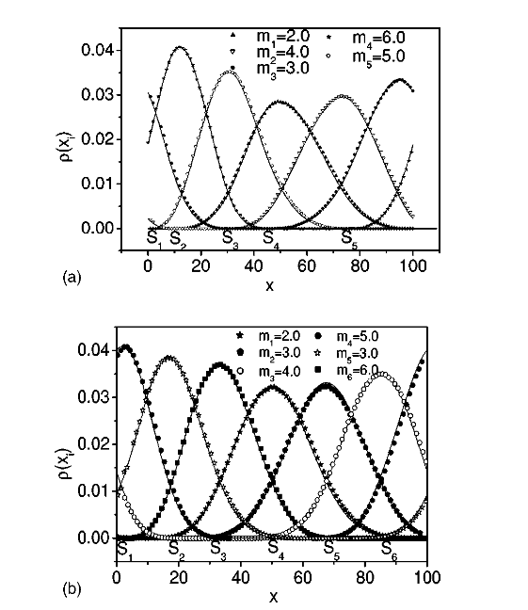
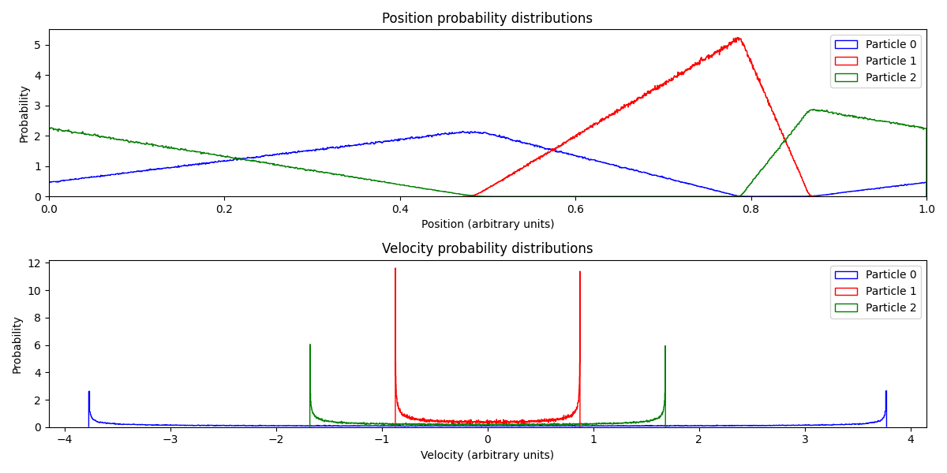
Haihong Li, Zhoujian Cao, and Gang Hu. “Analytical solution of space probability distributions of particles in a one-dimensional ring”. In: Phys Rev E Stat Nonlin Soft Matter Phys 67.4 Pt 1 (Apr. 2003), p. 041102. doi: 10.1103/PhysRevE.67.041102.

Slide 8
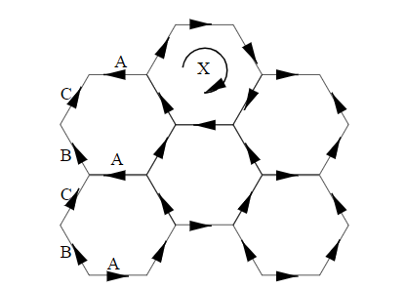
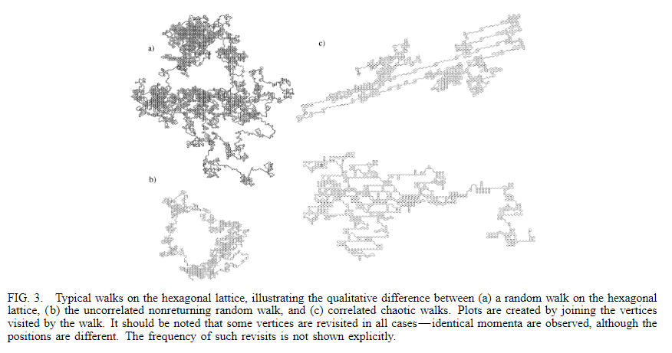
How to „measure” ergodicity?
- previous work: sequence of collisions in momentum space can be seen as applications of matrices on a momentum vector of all three particles
S. G. Cox and G. J. Ackland. “How Efficiently Do Three Pointlike Particles Sample Phase Space?” In: Phys. Rev. Lett. 84 (11 Mar. 2000), pp. 2362–2365. doi: 10.1103 / PhysRevLett . 84 . 2362. url: https : / / link . aps . org / doi / 10 . 1103 / PhysRevLett.84.2362.

Slide 9
How did we „measure” ergodicity?
We created binary strings
1. Label the particles: 1, 2, 3 (at the start of the simulation: x_1 < x_2 < x_3)
2. After a collision, the third particle has to collide with one of the previously collided ones
3. If this is the ‘left’ particle in the previous collision encode a 0, if its the ‘right’ particle encode a 1
4. Example: say the following collisions happen – 1 and 2, 0 and 1, 0 and 2, 0 and 1
5. The produced string is 001

Slide 10
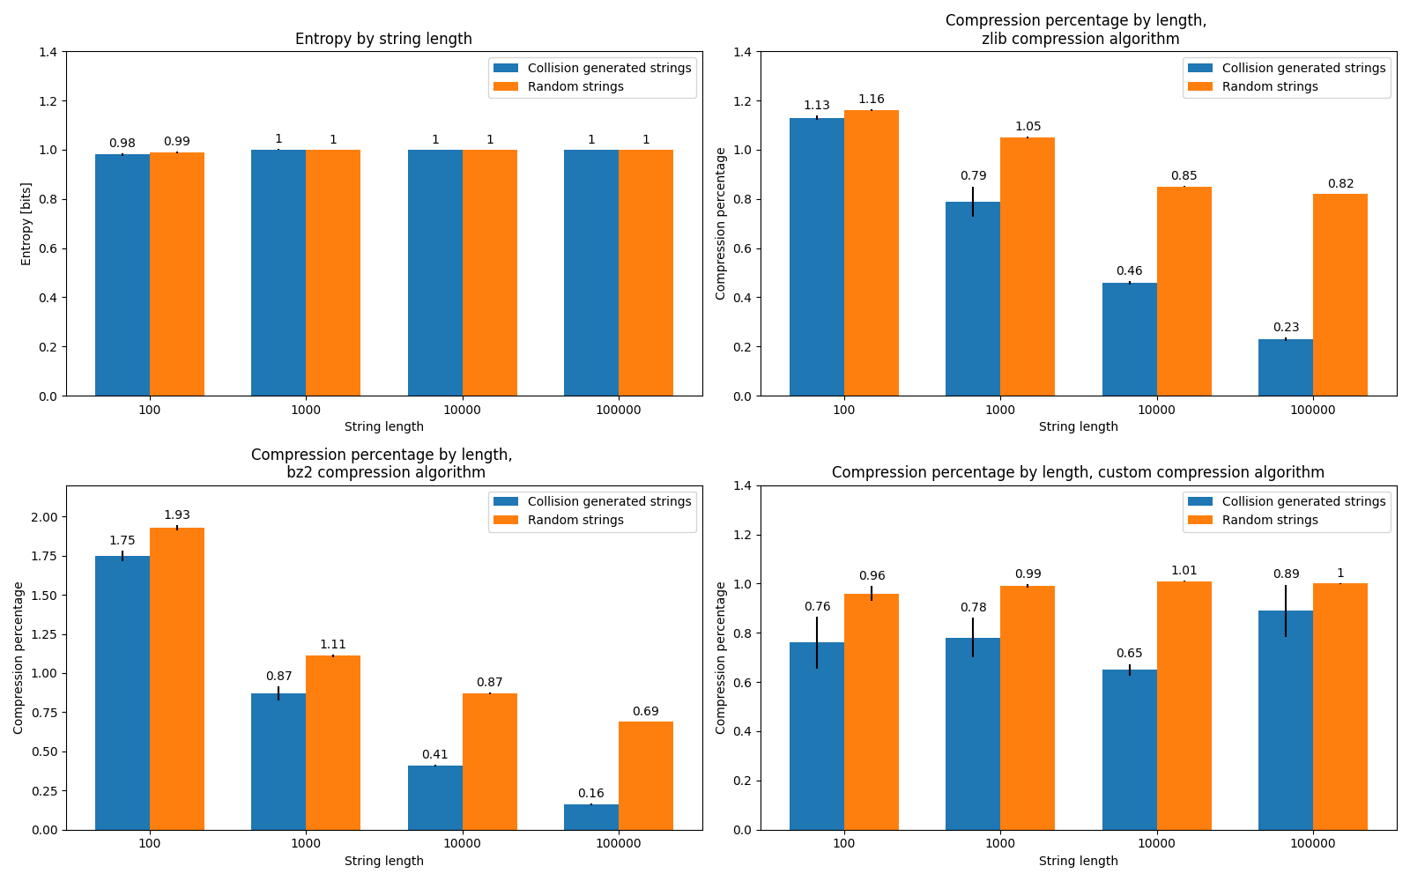
Comparison with random strings
Shannon information entropy
Custom compression: ‘aabbbc’ -> ‘2a3bc’
Notes:
- Mention how the results still need to be polished

Slide 11
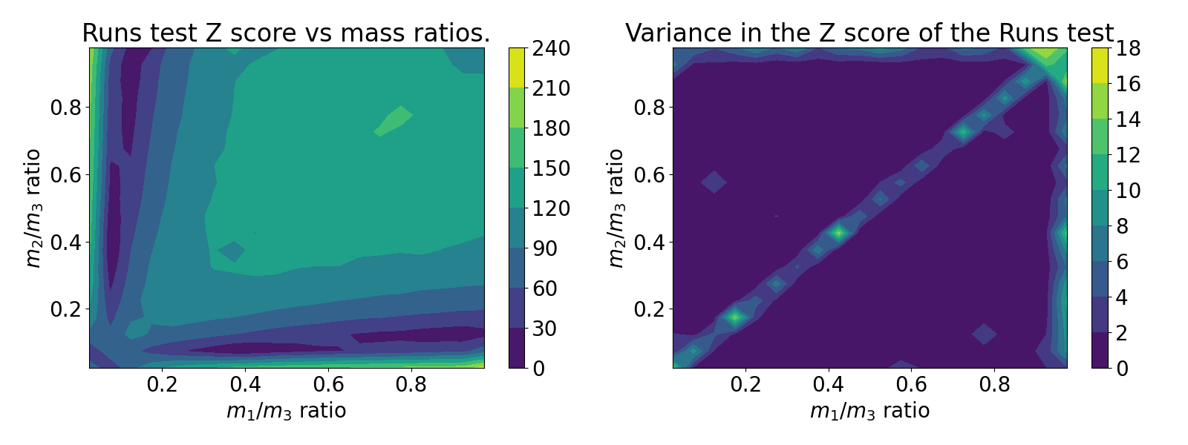
Runs test results
Notes:
Runs test:
Null hypothesis – sequence is random
Increasing runs n_1 and decreasing runs n_2
R = 2n_1n_2/(n_1 + n_2) + 1
Other diehard tests: monkey tests (based on the infinite monkey theorem), count the 1s test, minimum distance test

Slide 12
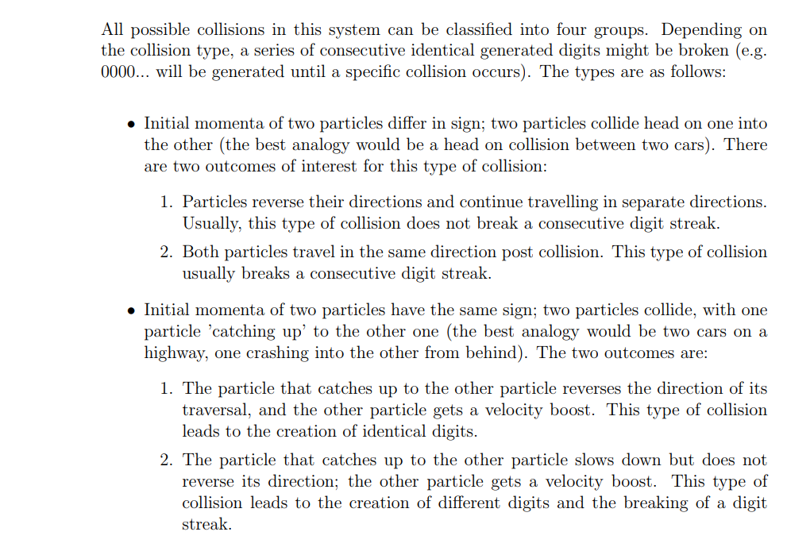
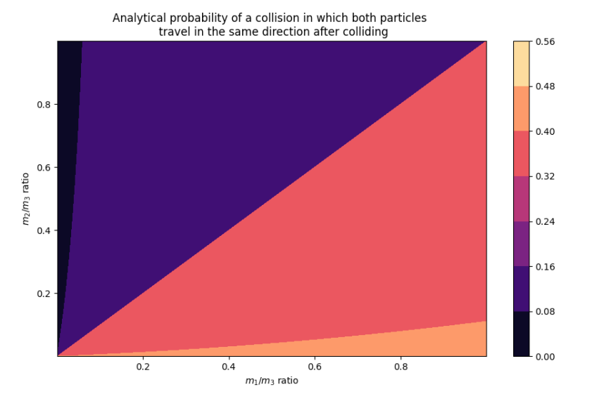
Analytical results

Slide 13

Questions

